Slide 1
TREATMENT OF UNITED AIRWAY DISEASE
Prof.Dr.Bulent Tutluoglu

Slide 2
Allergic Rhinitis treatment
Decrease in bronchial hyperreactivity
P=0.04
PC₂₀ metakolin (mg/mL)
Watson, JACl 1993; 91:97-101

Slide 3
With asthma treatment decrease in allergic rhinitis symptoms.
9
Plasebo
Budesonide
6
Nazal semptom skoru (0-9)
3
p<0.05
0
0 7 14 21 28 34 42 49
gün
Greiff et al. Eur Respir J 1998; 11: 1268-74.

Slide 4
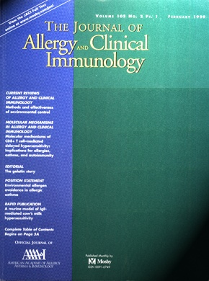
With rhinitis treatment decrease
in emergency department visits
due to asthma
Baena-Cagnani et al, Int Arch Allergy Immunol 2003
Nelson HS, JACI 2003
Crystal-Peters, JACI 2002
Fuhlbrigge, Curr Opin Allergy Immunol 2003
Adams et al. J.A.C.I. 2002
Notes:
4

Slide 5
ASTIM-RHINOSINUSITIS
Nearly 100% of severe , 77% of mild-moderate asthmatics have abnormalities in paranasal sinus tomographies!
If rhinosinusitis treated properly asthma symptoms get better.

Slide 6
Asthma-Rhinitis treatment

Slide 7
ANTIHISTAMINICS

Slide 9
ANTIHISTAMINIC DECONGESTAN COMBINATION
44 CENTER -274 PATIENTS ,5 WEEKS
PERENNIAL AR+ASTHMA
5 MG CETİRİZİNE+120 MH PSEUDOEFEDRİNE 2X1
AR,ASTHMA SYMPTOMS ,ASTHMA RELATED QUALITY OF LIFE
TOTAL COMPLEX SYMPTOM SCORE DECREASED 42.3 %
QUALITY OF LIFE SCORES IN ASTHMA IMPROVED
*Nathan RA.Ann Allergy Asthma Immunol 2001;86:9-17

Slide 11
MONTELUKAST

Slide 12
Efficacy of montelukast as an add on medicine in asthma and rhinitis
696 mild or moderate persistant asthmatics+allergic rhinitis patients
Patients taking steroid or combination therapy was put on montelukast therapy for 1 year.
Asthma attacks dropped from 31 % to 10%
Emergency room applications dropped from 19% to %4
Hospitalization rates dropped from 5% to 1
Oral steroid usage dropped from 6 % to 18%
Borderias L et al.,Curr Med Res Opin. 2007 Apr;23(4):721-30

Slide 13
Antihistaminics+montelukast
Desloratidine and montelukast given 2 hours before allergen provocation inhibits late asthmatic response and best responses are obtained by the combination therapy
Best results on late phase sputum eosinophilia have been taken by montelukast and desloratidine+montelukast combination
Davis B.Eur Respir J. 2009 Jan 22

Slide 15
NAZAL STEROİDLER

Slide 16
NASAL STEROIDS
3 YEAR RETROSPECTIVE COHORT STUDY –
13 844 PATIENTS
EMERGENCY UNıT VISITS DUE TO ASTHMA IN ANTIHISTAMINIC AND NASAL STEROID USERS
IN THE GROUP ANNUAL NASAL STEROID PRESCRIPTION 3 OR MORE COMPARED TO PLACEBO RR= 0.5
ANTIHISTAMINIC PRESCRIBED GROUP RR=0.9
*Adams RJ .J Allergy Clin Immunol 2002

Slide 17
NASAL STEROIDS-ASTHMA
14 STUDIES , 477 PATIENTS
INCREASE IN FEV1 IN 8 STUDIES
POSITIVE EFFECTS IN SYMPTOM SCORES IN10 STUDIES
BHR GOT BETTER IN 9 STUDIES

Slide 19
ANTİ IG E THERAPY-OMALİZUMAB

Slide 20
ANTI IG-E THERAPY(OMALIZUMAB)
IN MOST OF THE CLINICAL STUDIES DONE IN SEVERE ASTHMATICS : BESIDES POSITIVE EFFECTS ON ASTHMA SYMPTOMS RHINITIS SYMPTOMS GOT BETTER AND QUALITY OF LIFE INCREASED WITH OMALIZUMAB SIGNIFICANTLY

Slide 22
SPECIFIC
IMMUNOTHERAPY

Slide 23
EFFECTS OF IMMUNOTHERAPY
IMPROVEMENT IN AR AND ASTHMA SYMPTOMS AND DECREASE IN DRUG USAGE
POSITIVE EFFECTS CONTINUE LONG TERM AFTER CESSATION OF THERAPY
AVOIDANCE OF NEW ALLERGEN SENSITISATIONS
AVOIDANCE OF ASTHMA DEELOPMENT IN ALLERGIC RHINITIS PATIENTS

Slide 24
CAN WE PREVENT ASTHMA DEVELOPMENT IN AR PATIENTS?
118.754 allergic rhinitis who have no asthma
2006’da 2431 hastaya SCIT (%2)
Follow up between 2007-2012
In the group administered SIT there is a positive effect iin the avoidance of asthma development (RR=0.54)
SIT longer than 3 years has more positive effects than SIT that continued less than 3 years .
Schmitt J et al.J Allergy Clin Immunol. 2015 Sep 11.

Slide 27
Therapy Effectiveness in Rhinitis and Asthma
 | Rhinitis | Asthma
Allergen prevention measures | +/- | -
Antihistaminics | ++ | +/-
Beta agonists | - | +++
Anticholinergics | + | +
Chromones | + | +
LTRAs | + | +
İmmunotherapy | ++ | +
Anti Ig E -Omalizumab | ++ | ++

Slide 28
COPD- RHINITIS

Slide 29
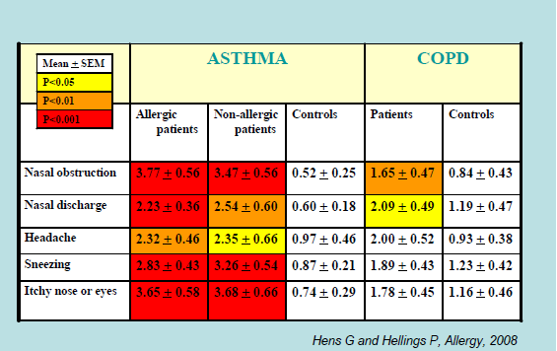
Sinonazal VAS skorları

Slide 30
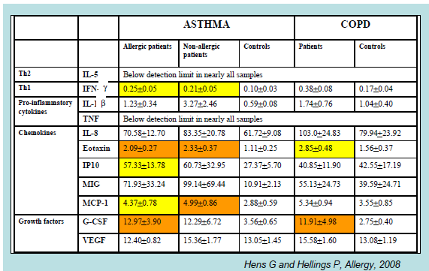
Nasal Lavage Analysis

Slide 31
COPD-NOSE
8649 COPD PATIENTS CHRONIC NASAL SYMPTOM SCORES
RECURRENT AND CONTINOUS NASAL SYMPTOMS
IN NORMAL PATIENTS : 33 %
IN COPD PATIENTS : 40 %
NAZAL SYMPTOMS WERE MORE PROMINENT IN SMOKERS
-- 8 YEARS FOLLOW UP IN THIS GROUP: THE GROUP WHO HAVE NASAL BLOCKAGE AND NASAL DISCHARGE DEVELOPMENT OF COPD WERE 2 FOLDS MORE
Montnemery P Eur Respir J 2001;17:596–603
Nihlen U,Clin Physiol Funct Imaging 2008;28:240–50.

Slide 32
COPD -NOSE
İrreversibl hava yolu obstrüksiyonu olan 290 hasta ve 421 kontrol:
SİNÜZİT:
HYO grubu: %12.4
Kontrol :%2.5
van Manen J Clin Epidemiol 2001;54:287–93.

Slide 33
COPD -NOSE
COPD PATIENTS WHO HAVE BACTERIAL COLONIZATION IN LOWER AIRWAYS , NASAL BACTERIAL LOAD IS GREATER.
THEY HAVE MORE POSTNAZAL DISCHARGE
ALTHOUGH SOME PATIENTS CEASED SMOKING, INFLAMATION IN THE NOSE CONTINUED
Hurst JR Chest 2005;127:1219–26

Slide 34
COPD -NOSE
Chronic Rhinosinusitis resistant to treatment:
Lower respiratory symptoms and abnormal spirometry……% 60
Increase in neutrophils in sinus lavage fluid in asymptomatic airway obstructed patients , this increase correlated with degree of obstruction
Treatment failure in COPD attacks
With sinusitis : 29 %
Without sinusitis 9%
Am J Rhinol 2004;18:15–21.
Rhinology 2005;43:11–7.
Am J Respir Crit Care Med 2006;173:71–8.

Slide 35
COPD-NOSE
42 % OF COPD PATIENTS HAVE CHRONIC NASAL SYMPTOMS
MMRC &SGRQ
SIGNIFICANT RELATIONSHIP BETWEEN NASAL SYMPTOMS –DYSPNAE AND QUALITY OF LIFE
Caillaud D.et al. Respirology 2013 ;19:346-352

Slide 36
COPD -BRONCHIECTASIS

Slide 37
CONCLUSION
Local treatment of allergic rhinitis helps in improvement of asthma symptoms
There are some data which reveals local treatment of asthma helps improvement in rhinitis symptoms.
Nasal problems should be questioned and should be treated and followed carefully
We have to consider upper and lower airways as a whole and consider comon therapeutic strategies
There should be tight cooperation between ENT and pulmonologists KBB ve Göğüs Hastalıkları Uzmanları arasında ortak hastalıklar konusunda sıkı bir işbirliği geliştirilmelidir.

